Slide 1

“Bridging the Gap”
Kristen Messer, M.Ed., BCBA, COBA
Updated 01/05/2026 by Sarah Shaw, MS, BCBA, COBA

Slide 2

Agenda
Neurodiversity
Trauma Informed Care
Ways to Help Kiddos
Quick Do/Do NOT
Visuals
A Bit About Behavior
Positive Reinforcement
Staying Safe

Slide 3
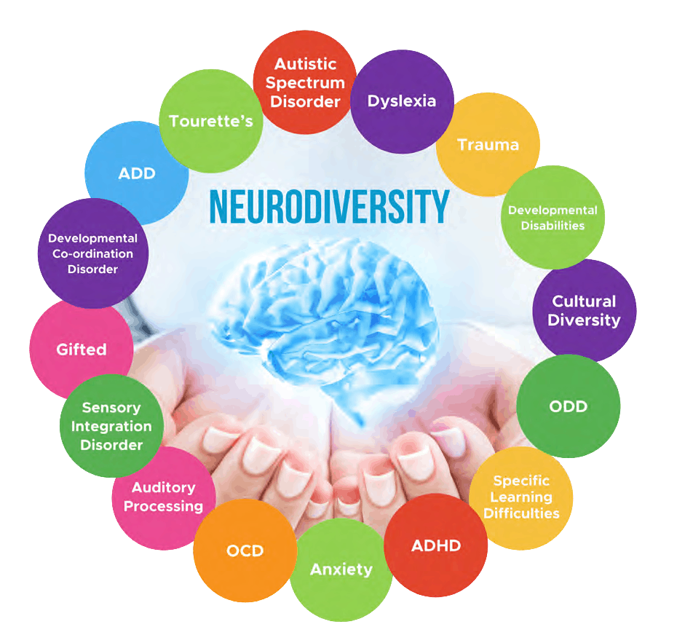
Neurodevelopmental Disorders
Group of conditions that typically are noticed during early childhood during early development
Impairments in personal, social, academic or occupational functioning
Ranges from very specific limitations to global impairments
Often co-occur (exist together)
Early identification is key

Slide 4

Neurodevelopmental Disorders
Intellectual disabilities (ID)
Measured by IQ tests
Show deficits in general mental abilities.
Effects reasoning, problem solving, planning, academics, etc.
Can be mild, moderate, severe, and profound and caused by syndromic or non-syndromic issues
Syndromic: medical condition such as downs syndrome or fragile X
Non-syndromic: not due do another medical or behavioral conditions

Slide 5
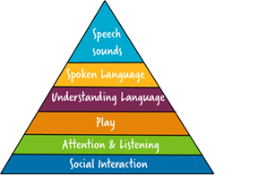
Neurodevelopmental Disorders
Communication disorders
Deficits in use of speech, language, social communication, etc.
Articulation disorder: difficulty producing speech sounds (ex: may say "fum" instead of "thumb")
Receptive language disorder: unable to understand language (ex: may not understand directions)
Expressive language disorder: unable to express themselves (ex: may use short phrases but unable to make longer sentences)
Pragmatic language disorder: challenges with social skills (ex: may not engage in a typical conversation or play with toys in a "functional" manner)
Notes:
Pyramid: bottom – up. First communicate through and learn social interactions, gain attention/listening skills, play skills, start to understand language, start to speak language, then learn correct speech sounds.

Slide 6
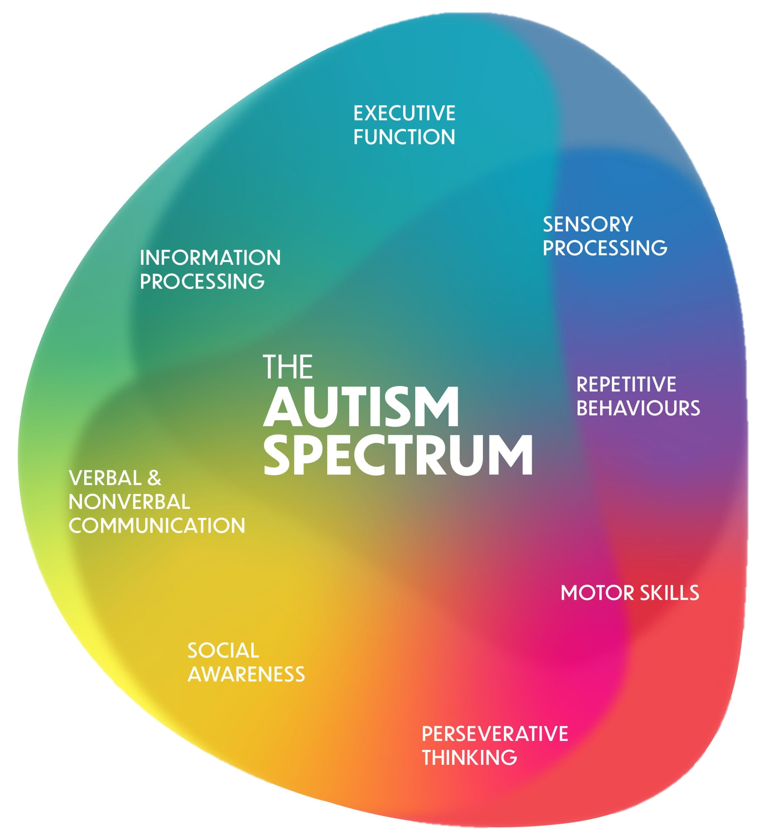
Neurodevelopmental Disorders
Autism
shows deficits in communication and social interactions across multiple contexts.
Hard time with social reciprocity, maintaining and understanding relationships, etc.
Sensory processing issues
Repetitive behaviors/ stimming
Processing information and executive functioning
Working memory, task initiation, flexibility, planning, time management, attention, organization, etc.

Slide 7
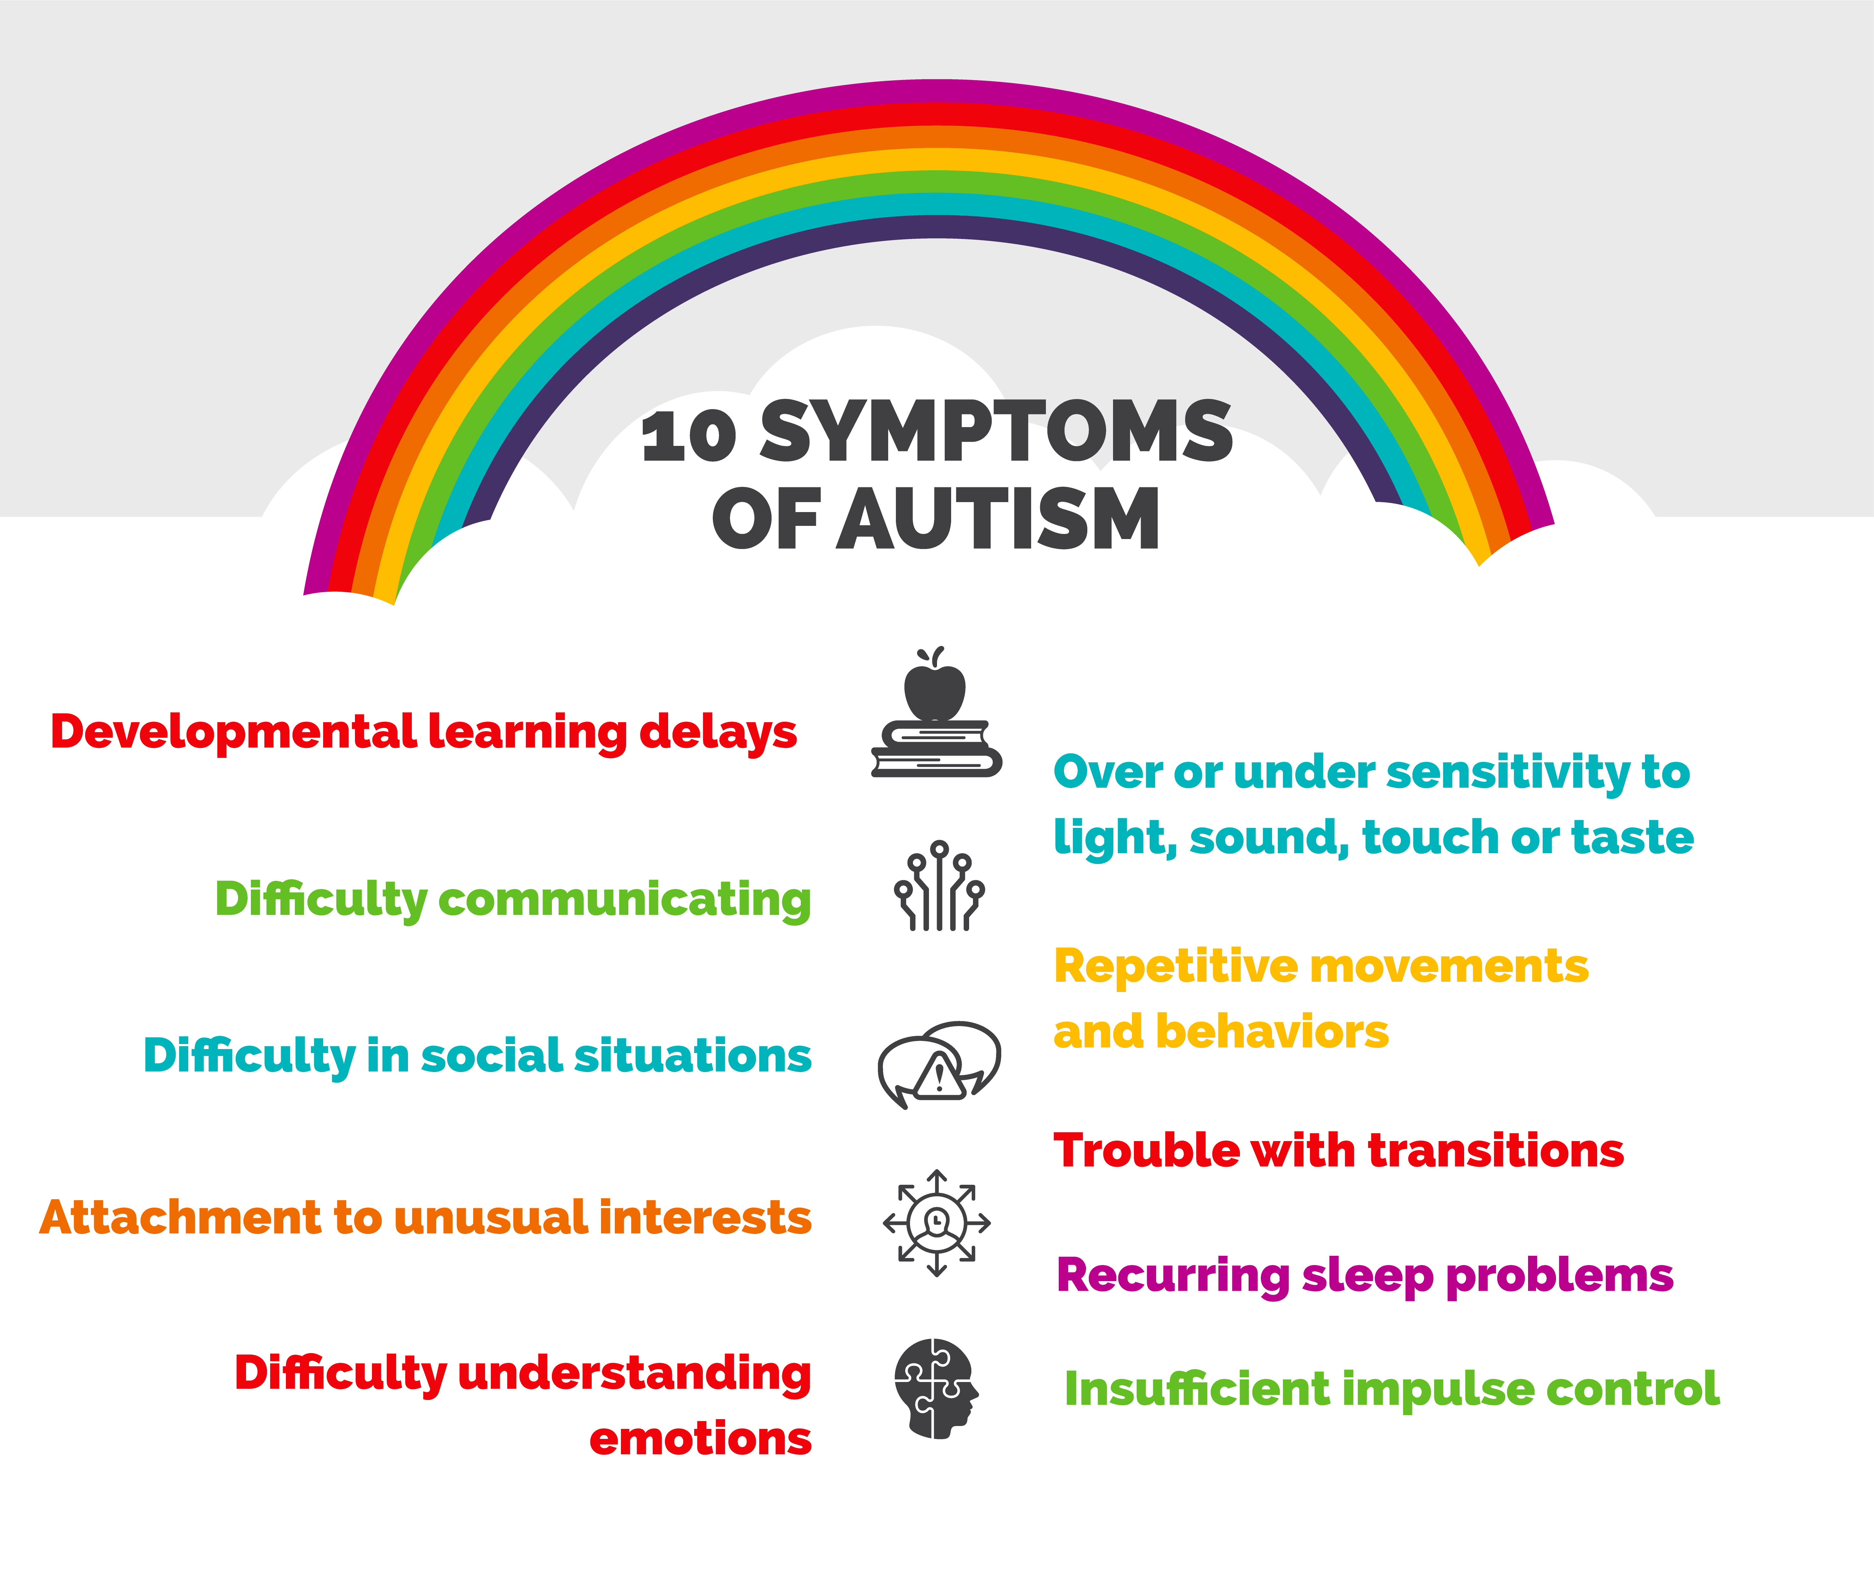

Slide 8
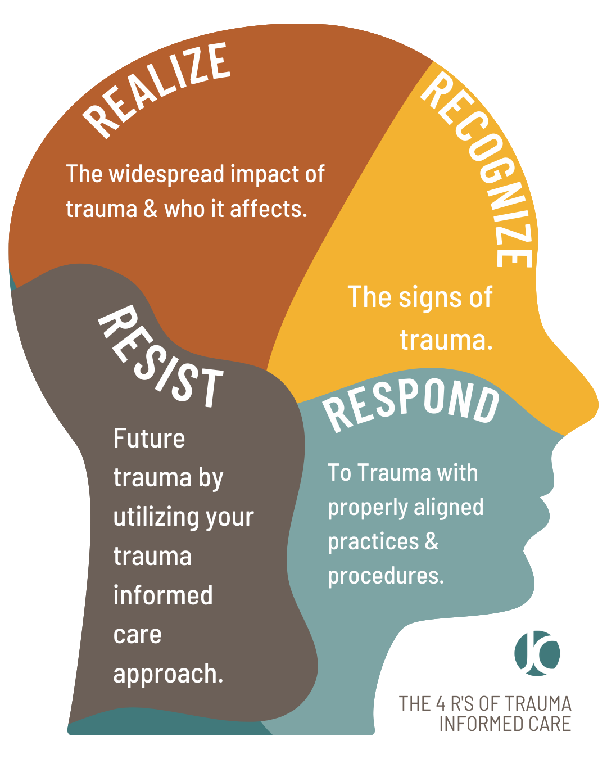
Trauma Informed Care
What is Trauma?
experience of abuse, neglect, loss, violence or witness of violence, terrorism, or disasters
Examples: medical intervention​, pain​, isolation, inability to communicate​, change in caregivers​, not getting needs met, multiple placements​, fears/anxieties, shame, repeated failures​, bullying​, confusion​, restraint/seclusion
Who it effects: EVERYONE Everyone has trauma of some sort!

Slide 9
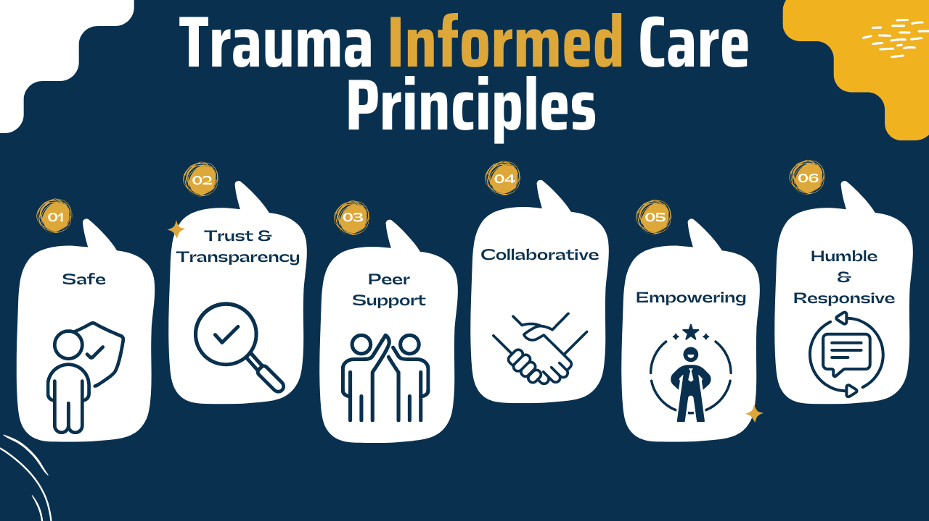
Universal precautions
Universal Protocols: Things we can do help EVERYONE who may have had/ is having trauma responses.
Think of how we used “universal precautions” for health during covid-19 times

Slide 10
How To Help
Environment
Provide a safe environment for all
Choices
Give as many choices as safety allows.
Recognize
Know the signs of issues arising in those you serve and work with
Response
Use this knew knowledge to change policy, practice, and procedures that aren’t currently aligned with the needs of students
Empower
Give the individual what is needed to build skills and be successful.
physically and emotionally
Save “Hard Nos” for when necessary
Triggers, precursors, etc.

Slide 11

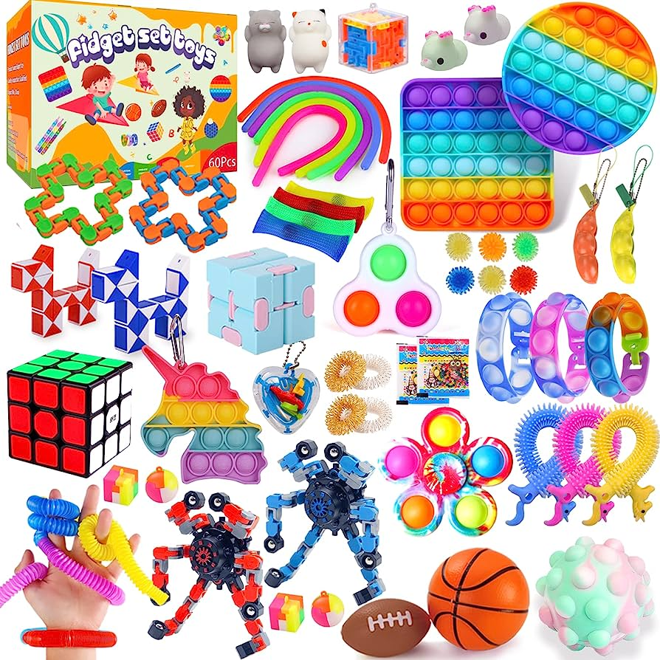

Environment
Safe
Easy to navigate
Tools available to make the experience easier:
Fidgets
Seating
Lightening
Noise

Slide 12
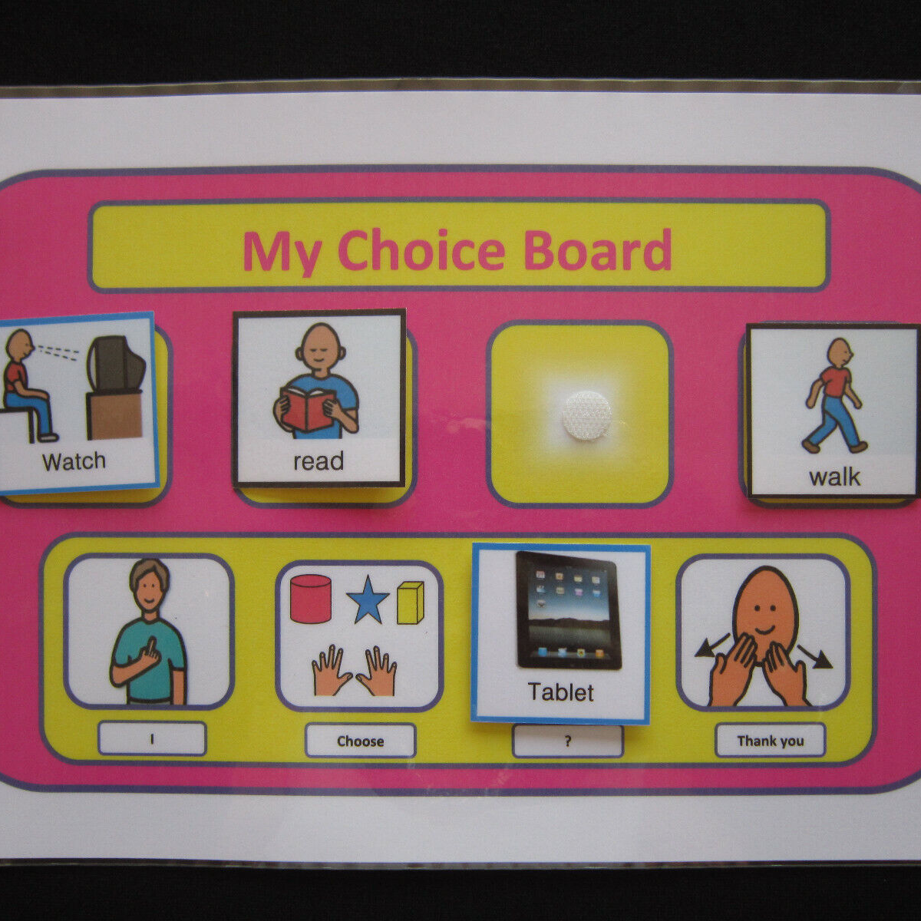
Choices
Provide choices wherever possible to ensure others have some control over the activity/situation
Save “hard no” for when safety requires this answer
What are some examples of ways to give choices?

Slide 13


Recognize
Understand what some signs and triggers may be
Examples:
Bright lights
Loud area
Uncomfortable seat
Deficits in communication/understanding
Other possible triggers
Sharing
Fire alarm
Others sitting too close
More?

Slide 14
Quick Dos and Don’ts
Do
Offer choices
Explain
Have visuals
Give warnings
Review expectations
Use small/ easy to understand phrases
Get on their level
Be hyper aware
Ignore non-dangerous behaviors!!!
Do NOT
Assume someone needs help with a situation
Give up!
Approach loudly or with too much expression
force compliance
Over clutter
Tower, touch, tell
Over think it

Slide 15
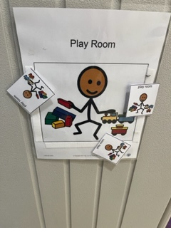

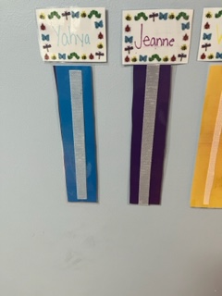
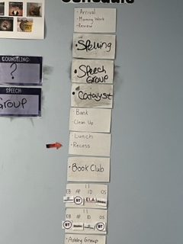
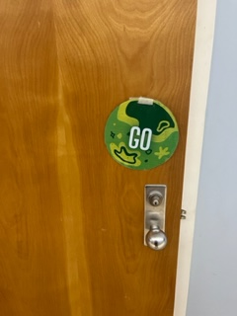
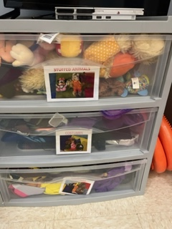
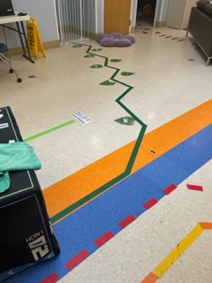
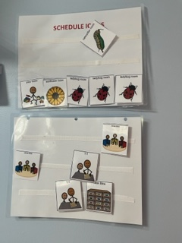
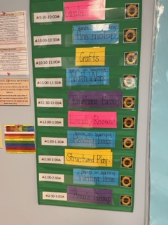
Examples of Visuals We Use…

Slide 16
Behaviors are Learned
Most behavior is learned – good behavior and challenging behavior​
A person can learn new ways of getting his/her needs met!​
Many things are learned inadvertently – our job to determine what keeps that behavior going.
Unlearning unwanted behaviors.

Slide 17
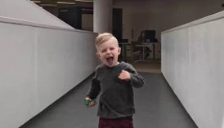

Four Functions of Behavior
Attention-Seeking
Access to Desired Items/Actions/Activities
Automatic
Escape or Avoidance

Slide 18
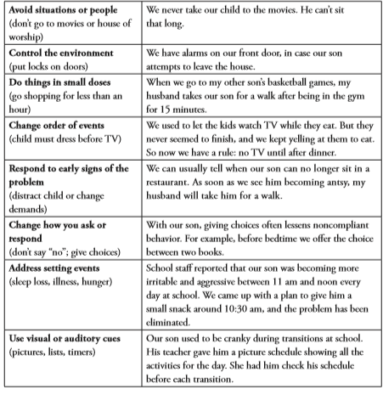
Eight Types of Prevention Strategies

Slide 19
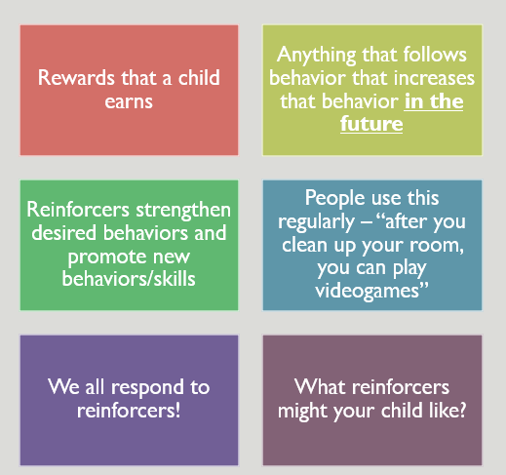
Positive Reinforcement

Slide 20
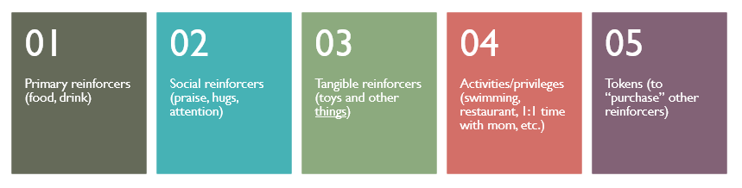
Types Of Reinforcers

Slide 21
How can we stay safe?
Ignore Non-Dangerous Behaviors
Avoid eye contact
Do not touch the child- walk away if necessary
Use a neutral facial expression- don’t react!
Do not talk to the child or respond to demands
Body positioning
Know what behaviors you child may engage in and position your body to avoid it
Clothing and Hair Pull stabilization

Slide 22
Questions, scenarios or comments?

Slide 23
References
American Psychiatric Association. (2013). Diagnostic and statistical manual of mental disorders (5th ed.). Arlington, VA: Author.
Fleisig, N., Winston, M. and Cuave, K. (2021) Professional Crisis Management Practitioner Manual . Sunrise, FL: Professional Crisis Management Association, Inc.
Harris, M., & Fallot, R. (Eds.)(Spring, 2001). Using trauma theory to design service systems. New Directions for Mental Health Services, 89. San Francisco: Jossey-Bass.
Wilcox, P. (2012). Trauma-Informed Treatment: The Restorative Approach. Massachusetts: NEARI Press

Slide 24




Thank you
Kristen Messer, M.Ed., BCBA,COBA
kmesser@newbeginningsbeahvioraltherapy.com
614-699-1819
Sarah Shaw, MS, BCBA, COBA
sshaw@newbeginningsbehavioraltherapy.com
631-278-0679

